Slide 1
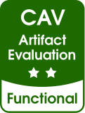






CROWN: OWNERSHIP GUIDED C TO RUST TRANSLATION
Hanliang Zhang, Cristina David, Yijun Yu, Meng Wang
Notes:
Hello everyone, I’m Hanliang Zhang, I’m glad to introduce our work, crown, blahblah. This is a joint work with Cristina, Yijun and Meng.

Slide 2

Rust the Programming Language
Performance
Low-level System Programming
High-level Abstractions
Memory Safety
Notes:
Memory Safety: guaranteed by ownership and lifetime system. In particular, instead of pervasively using raw pointers, Rust encourages the use of safe smart pointers like Box pointers, which owns some memory resources.
Let’s start with a simple introduction to the Rust language. Rust is a modern programming language that is focused on performance that is on par with C/C++; it allows programmers to write low level system codes with unsafe regions; it provides high level abstractions mechanisms like the trait system. Most importantly, it ensure memory safety with its ownership and lifetime system.

Slide 3








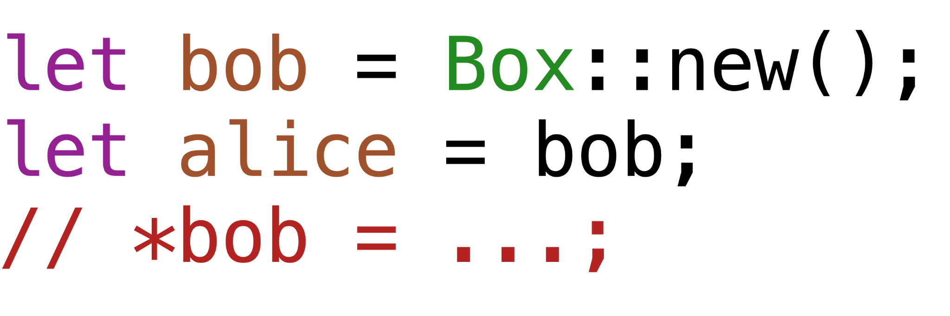
Ownership System
Notes:
Now we take a glance at the ownership system. It is very simple. We start with an allocated memory resource, and it’s owner, the boy. The uniqueness of ownership is the key property of the ownership system.
The crucial property of an ownership system is that the owner has to be unique. This the key to prevent many safety bugs like double free, uAf and data races.
Ownership can be transferred as well. Now obviously we’ve seen an frowning face on the left, since he can no longer have access to the memory resource, the uniqueness is guaranteed.
Question: what is borrow:
Rust uses the concept of borrowing, which refers to creating a reference (marked by an ampersand). A reference allows referring to some value without taking ownership of it.

Slide 4








Rust Grown Popular
Rust has become a popular language:
Research on C to Rust translation:
Syntax-based translator: C2Rust [inc., I.] and Crusts [Ling et al. ICSE]
Translator based on compiler errors [Emre et al. OOPSLA]
Our Idea: static analysis that infers ownership information
Unsafe raw pointers to Rust Box pointers
Notes:
Rust has become popular language. It’s been used by many Big tech companies, and it has become the second official language in linux. Much attention has also been drawn on automatic C to Rust translation. There are syntax based translators C2Rust and Crusts, which turns C pointers into unsafe Rust pointers, which does not have any safety guarantees. Built on top of these base translators, there are translators that generate fixes according to compiler errors, to turn unsafe pointers into safe pointers. In this work, our idea is to devise an static analysis that infers ownership information from the underlying C programs, and we attempt to translate more unsafe pointers into safe pointers.

Slide 5


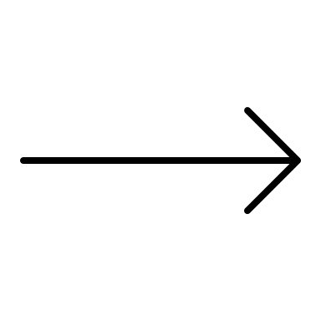

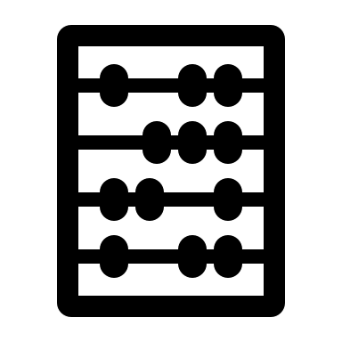


Workflow of Crown
C code
Base Translator
Ownership Monotonicity
SAT Solver
Unsafe Rust code
Ownership Constraints
Safer Rust code
Rust Ownership Model
Aliasing
Notes:
Now we have an overview of the workflow of Crown. We start from some C code and a base translator C2Rust. By applying the base translator, we obtain unsafe Rust code, where no ownership information is inferred, and the program is with no memory safety guarantees. The analysis module of crown will scan over the code and generate a set of ownership constraints. Subsequently, by using a SAT solver, the set of constraints is checked agains Rust ownership model. Finally, by using the ownership information, our tool attempts to re-type pointers and rewrite their uses.
However, the analysis is not as easy as it seems. In the presence of commonly used C idioms like inductively defined data structure, pass by reference, where many multi-level pointers exist, pointer alias becomes a major problem during constraint generation. In this work, we devise a strengthening model, which we call ownership monotonicity, which alleviate the need for an alias analysis.

Slide 6
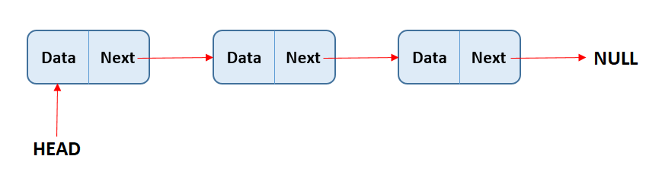
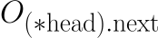
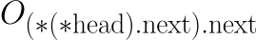

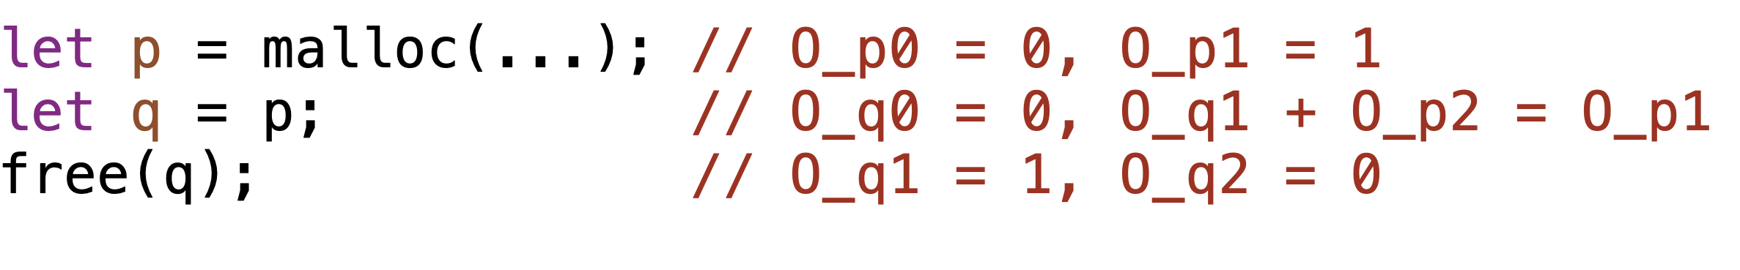
Ownership Analysis
Field Sensitivity
Flow Sensitivity
Performance
Notes:
Now let’s take a closer look at the ownership analysis. Our analysis associate ownership variables to pointers. Those variables take 0/1 values, where 0 means non-owning and 1 means owning. For field sensitivity, we associate ownership variables to pointers that are accessible from a program variable, and apply a k-limit when we unwrap the access path. For instance, in this singly linked list, we associate variables for head, head.next, and head.next.next.
For flow sensitivity, we track ownership status at each locations using an SSA like algorithm. For example, in the first line of the following program, we have two constraints of the program variable p, which reflects the ownership status before and after this statement. To encode a possible ownership transfer, we use a linear integer constraints

Slide 7
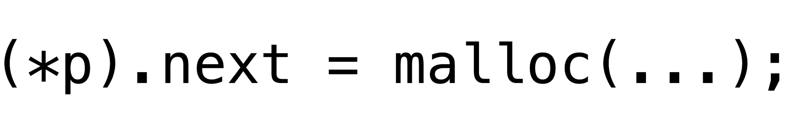
Ownership and Aliasing
p
q
(*p).next
(*q).next
(*p).next
Notes:
As mentioned before, aliasing poses a major challenge to the design of ownership analysis. We illustrate the problem with the following simple scenario. Suppose we have a singly linked list, where `q` is the head pointer. Also suppose that `q` and its child node are already inferred to be owning pointers. Suppose additionally `p` is an alias to `q`. Now to satisfy the uniqueness property, `p` must be non-owning. Also, (*p).next and (*q).next are alasing pointers, and (*p).next must be non-owning.
The aliasing problem occurs when the following statement are analysed: a newly allocated memory resource is assigned to (*p).next. Now if we trivially update the ownership status of the corresponding variables, the system may end up with two owners. Note that this assignment does not change the fact that `p` and `q` are aliases, and (*p).next and (*q).next are still the same objects.
this example illustrates that to infer proper ownership information, one will need precise alias analysis. Please bear in mind that we track ownership information field/flow sensitively, such alias information is difficult to compute and the results tend to be imprecise

Slide 8
Ownership Monotonicity
Notes:
In this work, instead of pursuing a precise alias analysis, we impose an strengthening to the ownership model. Apart from normal ownership constraints, we associate additional monotonicity constraints, which says the ownership value can only decrease down an access path. For instance, for a head pointer to a singly linked list, we inforce that O_head >= O_(*head).next and so on.

Slide 9

Ownership Monotonicity
p
q
(*p).next
(*q).next
Notes:
With monotonicity, it is not allowed to allocate or deallocate indirectly through an already non-owning pointer, therefore,, the constraint generated for the previous scenario does not satisfy the model, and this part of the program will be left as unchanged and unsafe.
We prove that with ownership monotonicity, our analysis is sound with respect to the uniqueness property. But we must note that due to monotonicity, certain safe programs are rejected.

Slide 10
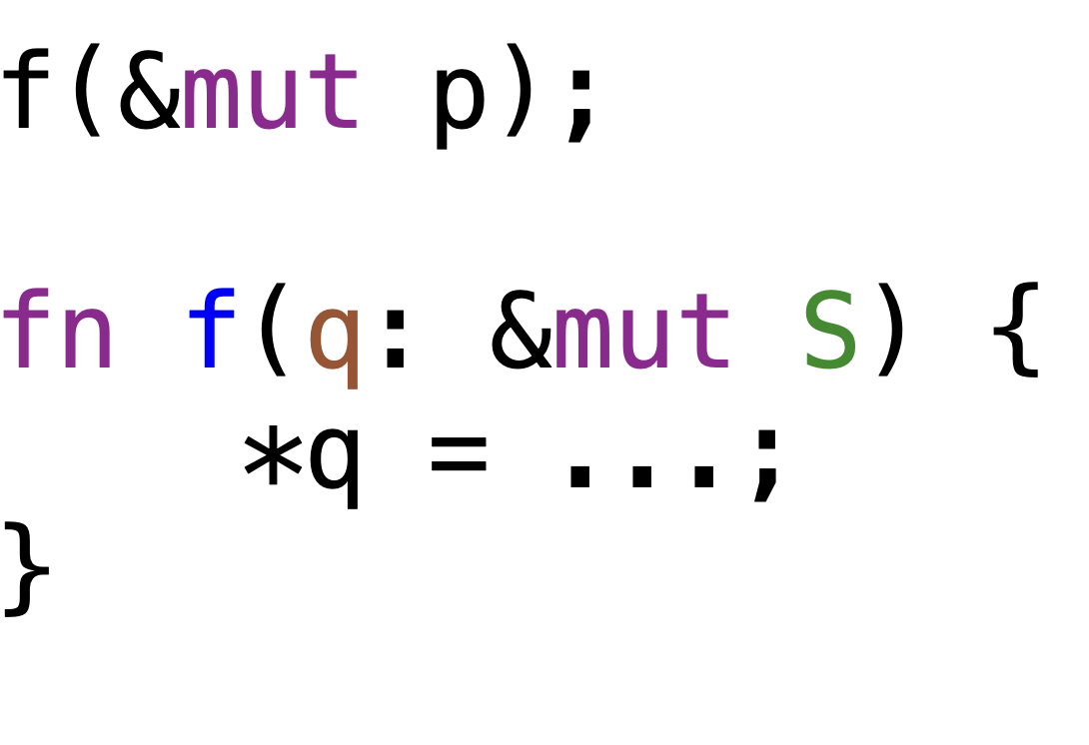
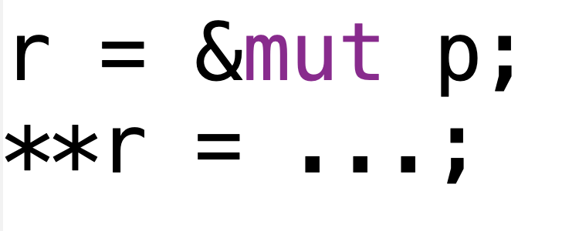
Borrowing
Reference Output Parameter
Local Borrow
Notes:
Let’s now look at borrowing. So Borrowing means taking a reference or say address of some object to do something without acquiring ownership. Since monotonicity rejects non-owning pointer that points to owning pointers, it rejects many borrowings.
We identify two kinds of borrow. The first kind is a borrow on the function parameter positions, where we can pass the address to a function, and inside that function modifies indirectly through the pointer. The second kind is local borrows, where an address is taken and accessed within a function.
Based on some empirical studies and observations by some previous work, the previous scenario composes most of the case of borrow. So in practise, we make a special case for the first scenario. For the details of this, we refer to the paper.

Slide 11
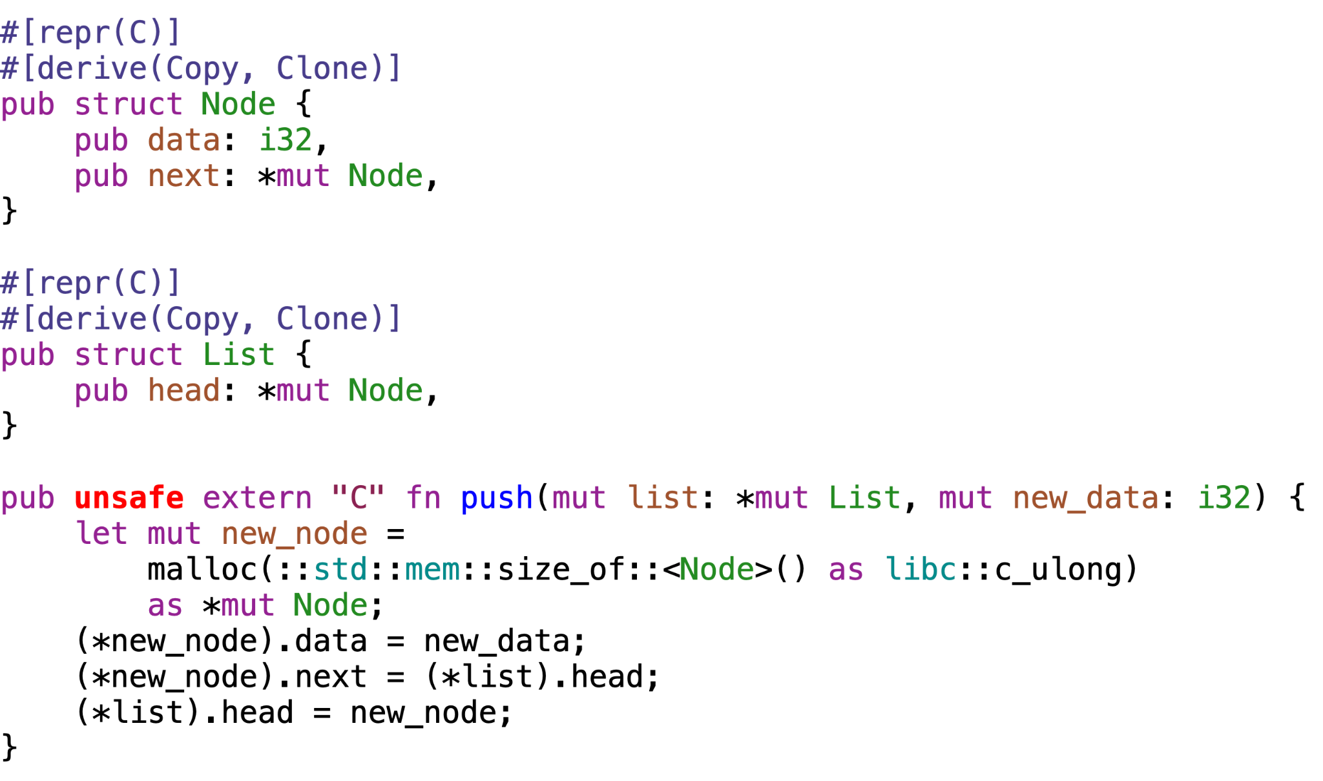
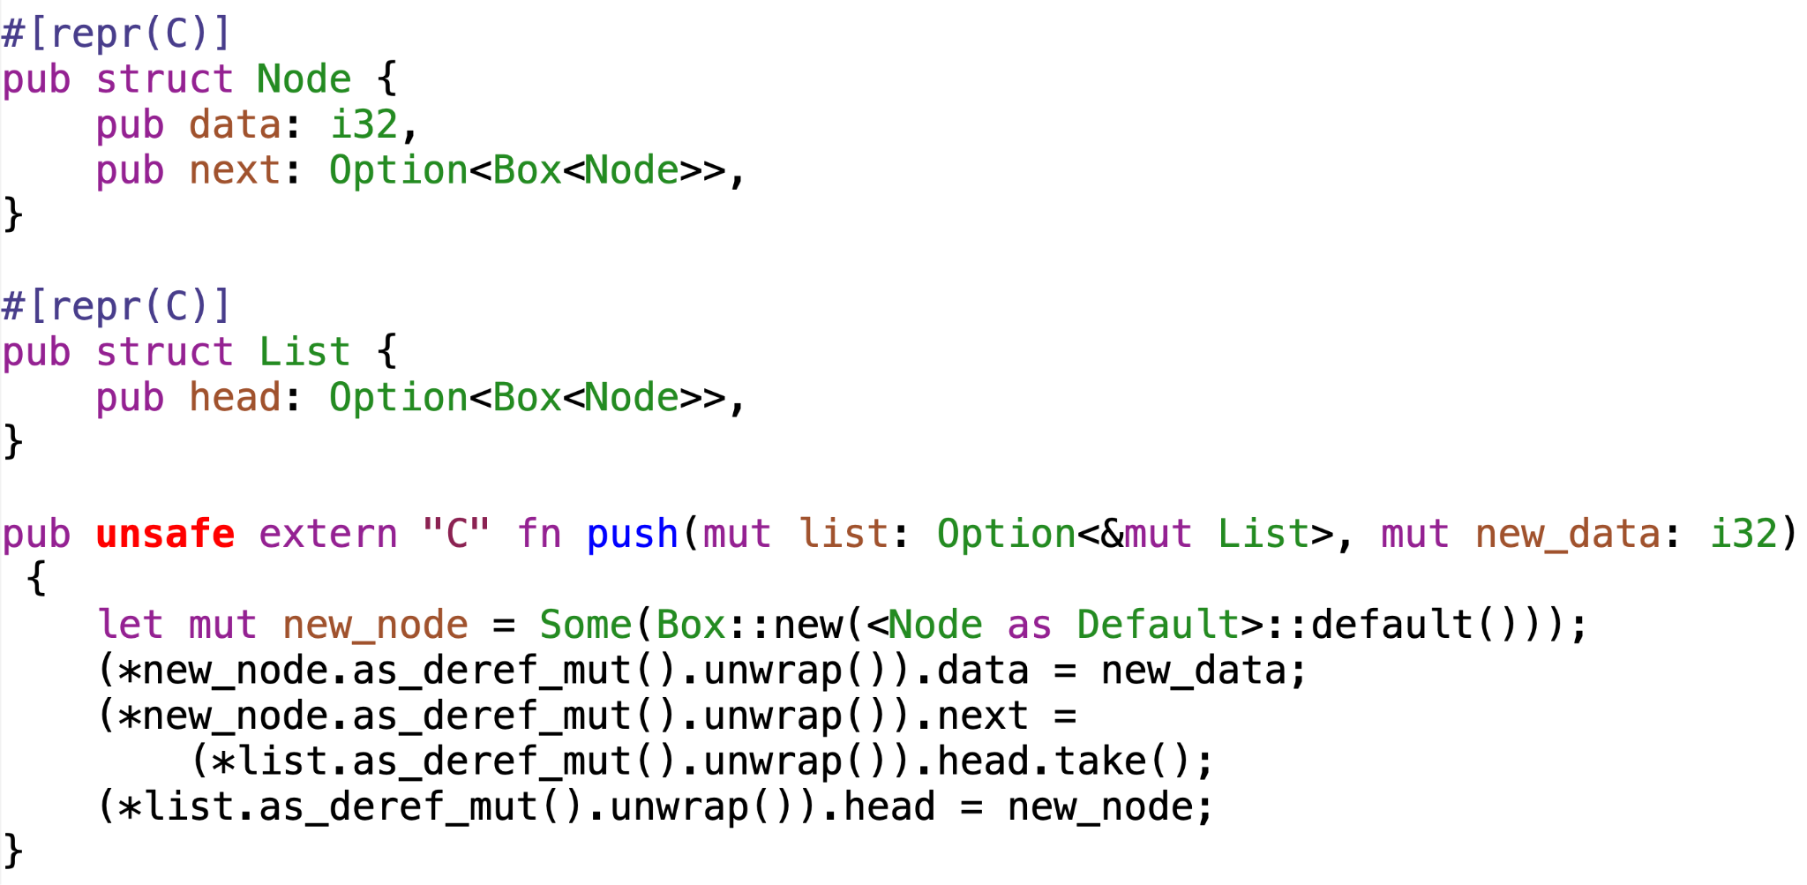
Safe
Unsafe
Notes:
So much for the analysis, let’s now take a look at the translation results. The program on the left is an unsafe Rust program, which is an implementation of a singly linked list and its `push` method. The program on the right is the translation results. By utilising ownership information, crown is able to perform re-type properly.
Note that we wrap every safe pointers with an Option type, to imitate the nullability of unsafe raw pointers.
The field definitions are retyped, and the local variables are retyped to safe pointer types. Also, the uses of those pointers are rewritten as well. Because of the option wrapper, the resulting code is slightly complicated than the original code.

Slide 12
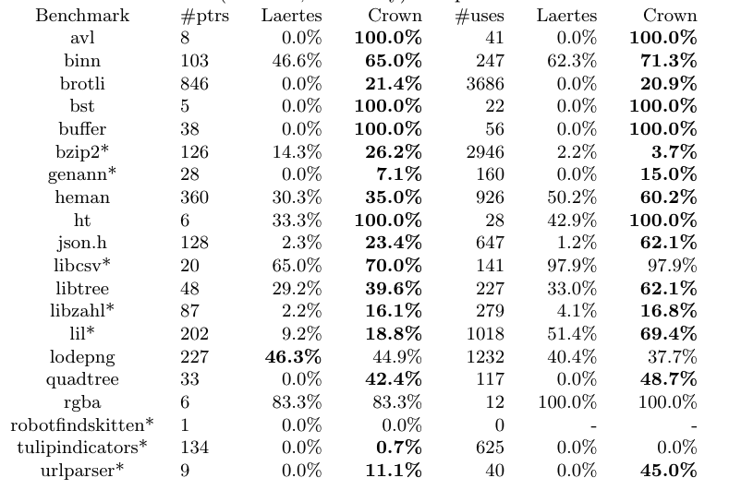
Evaluation
> 500k LOC
< 10 s
Notes:
We evaluated our tool over 20 benchmarks, including realworld C projects and some commonly used data structures. To measure the efficacy of our tool, we compute the reduction rate of unsafe mutable non-array pointers and their uses. We also compare our tool with the current STOA which is published in OOPSLA. The evaluation shows a solid improvement. We use bold here to represent better result.
Due to the high complexity of real world code, we were not able to handle certain C constructs like function pointers, unions.

Slide 13
Conclusion
An ownership analysis based on the novel notion of ownership monotonicity
Empirically evaluated the proposed method over real world benchmarks
Tool Available at https://github.com/KomaEc/crown

